Slide 1

Substance Use Disorder 101
“Addiction”
Regina Spicer, LSW, LICDC-CS-R
Training Officer

Slide 2
Objectives
Define Substance Use Disorder
Recognize signs and symptoms of addiction
Understand risk factors associated with substance use
Learn about common drugs of abuse
Become familiar with community resources

Slide 3
ICE BREAKER
Notes:
Identify one word that describes a person on crack or heroin
Identify one word that describes a person with cancer
Note the difference in identifiable labels - Pause for silence

Slide 4
Why Do People Use Drugs?
To Feel Good – feeling of pleasure “high”
To Feel Better – i.e., relieve stress, social anxiety, depression
To Do Better – improve performance, focus
Curiosity and Peer Pressure – teens are at risk, wanting to impress friends
Notes:
Discussion with audience
People with addictive disorders may be aware of their problem, but be unable to stop it even if they want to.
The misuse of drugs and alcohol is the leadin

Slide 5
Brief History
Scientist began to study addictive behavior in the 1930’s
People addicted to drugs were thought to be morally flawed and lacking willpower
Views shaped society’s responses to drug use and treated it as a moral failing rather than a health problem
This led to punishment rather than treatment
Thanks to research, addiction is now viewed as a medical disorder that affects the brain and changes behavior

Slide 6
Stigma of Addiction
Prejudice, stereotypes, and discrimination
Greatest barrier to helping individuals with substance use disorders get the help they need
Creates shame, guilt, and fear
Stigma prevents people in need from receiving help.
Cultural rejection prevents individuals with addiction from finding work, maintaining stable housing, and providing for themselves.
Notes:
Encourage to identify own biases regarding substance use
Talking about substance use disorders or mental illness was once taboo. Even today most people don’t treat people with mental health conditions or substance use the same way they treat people affected by other serious diseases.
Just like cancer is treatable; substance use is treatable, as well, and requires empathy and support.
Neither have any bearings on economic status – No one chooses to have a substance use disorder, mental illness or cancer.
The taboo or stigma creates shame, guilt, and fear which can lead to isolation
Reducing stigma isn’t easy due to misconceptions and prejudice
Treat people with respect
Be educated about substance use disorder
Become familiar with community resources

Slide 7
Addiction Stats
40 million Americans ages 12 & older-or more than 1 in 7 people-abuse or are addicted to nicotine, alcohol, or other drugs.
More than the number of Americans with:
  Heart Conditions – 27 Million
  Diabetes – 26 Million
  Cancer – 19 Million
  National Institute of Health (NIH)
Notes:
The misuse of drugs and alcohol is the leading cause of preventable illnesses and premature death.

Slide 8

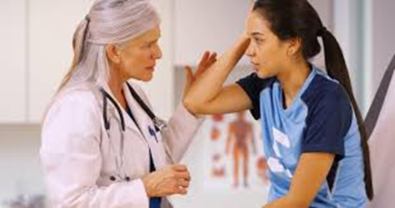


Affects of Drug Use on Society
Use and misuse of alcohol, nicotine, and illicit drugs, and misuse of prescriptions drugs cost Americans more than $700 billion a year in increased health care costs, crime, and lost productivity. Every year, illicit and prescription drugs and alcohol contribute to the death of more than 90,000 Americans, while tobacco is linked to an estimated 480,000 deaths per year.
Legal
Social
Medical
Economics

Slide 9
What is Drug Abuse?
Abuse and Addiction are used interchangeably
A person can abuse drugs without necessarily becoming addicted
Abuse is the way a person uses the drug other than how it was prescribed, including alcohol or cigarettes
Can appear casual, but will use the drug for the feeling – “high”
Notes:
There is a difference between drug abuse and drug addiction

Slide 10
Definition of Addiction?
A chronic, relapsing disorder characterized by compulsive drug seeking and use despite adverse consequences. It is considered a brain disorder, because it involves functional changes to brain circuits involved in reward, stress, and self-control, and those changes may last a long time after a person has topped taking drugs
National Institutes of Health (NIH)
Notes:
Ask the question – What is Abuse?; What is Dependence (Addiction)?; Does everyone who use drugs become addicted?
Not everyone on drugs becomes addicted.
Each person’s brain and body are different.
People react to drugs differently. There is no rule about how soon someone will become addicted. It can happen quickly or take time.
Addiction can take over your life and can become more important than eating or sleeping

Slide 11
Diagnostic Statistical Manual (DSM 5)
According to the DSM-5
A definitive and unique pattern of behavioral and physiological symptoms have been identified for substance use disorders
Substance use disorders manifest themselves similarly in most people and have predictable series of symptoms
Notes:
We will discuss the signs and symptoms of addiction

Slide 12
Drug Addiction
Addiction is a lot like other diseases, such as heart disease or cancer. They are illnesses.
Both disrupt normal, healthy functioning of an organ in the body
Both have serious harmful effects
Both, in many cases, are preventable and treatable
If left untreated, can last a lifetime and may lead to death
National Institutes of Health (NIH)
Notes:
Refer back to the labels of drug use and cancer
Addiction is not a weakness. It does not mean someone is a bad person.
People from all walks of life can become addicted. It crosses all socio-economic lines
Can happen to anyone at any age.
Chances of addiction become greater the younger someone is when they start using drugs.
It is treatable

Slide 13
Co-Occurring Disorders
When you have both a substance abuse problem and a mental health issue such as depression, bipolar disorder, or anxiety, it is called a co-occurring disorder or dual diagnosis and can range in severity – mild, moderate to severe
More common than most people realize
Both the mental health and the drug or alcohol addiction have their own unique symptoms that can get in the way of one’s ability to function at work, school, maintain a stable home life, handle life’s difficulties, and relate to others
Either disorder –substance use or mental illness – can develop first and the co-occurring disorders can also affect each other
Notes:
Need for more integrated treatment services. Generally, the disorder that gets treated initially, is the disorder that presents itself.
Substance Disorders and Mental Health must be treated simultaneously in order to be beneficial and effective for the individual
Some substance abuse can cause prolonged psychotic reactions, one does not directly cause the other.
Substance use and mental health can develop in tandem
Alcohol and drug abuse can increase the underlying risk for mental health disorders

Slide 14
Stages of Addiction
Experimental Stage
Social Stage
Risky Stage
Instrumental Stage
Compulsive Stage
Notes:
Experimental Stage – May be simple curiosity, a rite of passage into a social group, or the result of peer pressure. This is a short term random use of one or more drugs.
Social Stage – Person’s feel normal, but the use of the drug is a big part of social acceptance and identity. Occurs most often when friends get together occasionally to take the drug out of interest or pleasure.
Risky Stage – Now takes the drug for a specific purpose; for pleasure or to cope with anger, shame, guilt, boredom, stress, or loneliness. Signs of dependency begin to appear. Drifts away from old friends and spends much more time with new drug using friends.
Instrumental Stage – The main desire is to get high. This is tolerance, leading to more drug use, and extreme mood swings. No longer feels normal either high,
with the drug, or irritable, anxious, depressed, craving the drug.
Compulsive Stage – Preoccupied with the drug and will do anything to get it, including theft and prostitution. Will hide drugs, even from friends. May not recognize their dependence, but become lost in arrogance and illusions of grandiosity.

Slide 15
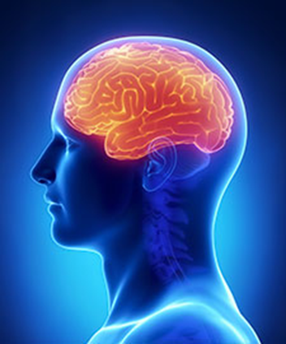
How Does Drug Use Become an Addiction?
What’s the connection between addiction & the brain?
Notes:
No single factor determines whether a person will become addicted to drugs or not. It differs from person to person
Drugs interfere with the way the brain works

Slide 16
Videos
https://www.youtube.com/watch?v=rJSDgvWQSYI
Addiction and the Brain
https://www.youtube.com/watch?v=SufLpGPauII&t=5s
The Swiss Cheese Model of Addiction

Slide 17
Addiction Signs & Symptoms
Often taken in larger amounts than intended
Unable to cut down or reduce use
Lots of time spent to obtain, use, or recover from substance
Craving the substance
Failing to fulfill obligations, i.e. work, school
DSM-V
Notes:
Let’s look at signs and symptoms – the predictable ones

Slide 18
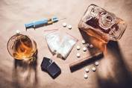
Addiction Signs & Symptoms
Continued use despite consequences
Giving up or reducing activities because of use
Repeated use in dangerous situations
Continued use despite mental or health problems
Tolerance
Withdrawal
Notes:
Discuss and physical and behavioral signs of addiction
People with substance use disorder have distorted thinking, behavior and body functions.
Changes in the brain’s wiring are what cause people to have intense cravings for the drug making it hard to stop using.
Causes harmful changes in how the brain functions and can last an indeterminate amount of time

Slide 19
Physical Signs
Unusual laziness, awake at unusual times
Change in eating habits
Extreme hyperactivity
Slowed or staggered walk
Needle marks
Runny nose
Substance Abuse and Mental Health Services Administration

Slide 20
Physical Signs
Frequent rubbing of the nose
Frequent twisting of the jaw, back and forth body rock
Deterioration of hygiene and physical health
Tremors or shakes
Unusual smells – body, breath, clothes
Pupils larger or smaller than usual
Substance Abuse and Mental Health Services Administration

Slide 21
Behavioral Signs
Change in attitude/personality
Drop in grades or school performance
Change in work ethics
Chronic dishonesty, stealing, increased need for money
Irritability or anger for no reason, moodiness
Difficulty paying attention, forgetfulness
Substance Abuse and Mental Health Services Administration

Slide 22
Behavioral Signs
Lack of motivation, energy, self-esteem, “I don’t care attitude”
Paranoia, secretive or suspicious behavior
Car accidents
Changes in friends, personal grooming habits
Possession of drug paraphernalia
Substance Abuse and Mental Health Services Administration

Slide 23
Who is Affected by Addiction?
Babies
a. Womb exposure – premature and underweight
b. Slows ability to learn and may affect behavior later in life
c. May become dependent on opioids or other drugs use by the mother during pregnancy
Teens
a. May act out and do poorly in school or drop out
b. Using drugs when the brain is still developing may cause lasting brain changes and increase risk of dependence

Slide 24
Who is Affected by Addiction?
Adults
a. Problems thinking clearly, remembering, and paying attention
b. Poor social behaviors, work performance, and personal relationships suffer
Parents’
a. Chaotic, stress-filled homes,
b. Child abuse or neglect
c. Loss of family, children and other meaningful relationships

Slide 25
Who is Affected by Addiction?
Elderly
a. Prescription Drugs
b. Alcohol
c. Stressors of Aging

Slide 26
Risk Factors for Addiction
Lack of attachment to healthy adults/mainstream culture
Genetic/Biological factors
Personal characteristics (i.e. high vulnerability to anxiety/depression; impulsiveness, etc.)
Health/Mental Illness
Sex/Gender
Early drug use
Notes:
Internal Factors contributing to use/addiction

Slide 27
Risk Factors for Addiction
Abuse from the family and others
Culture references that encourage drug use
External Stressors i.e. poverty; job stress; single parenting; unemployment; divorce
Exposure to trauma
Availability of substances
Peer Group
Notes:
External Factors contributing to use/addiction

Slide 28
Classification of Drugs
Classified by the effects they have on Central Nervous System:
Stimulants
Depressants
Hallucinogens
Opioids

Slide 29

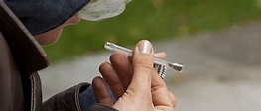
Drugs of Choice
Stimulants – Long term health problems. Increases alertness, breathing, blood pressure, and heart rate. Can produce hostility and psychotic symptoms
  Amphetamines – speed
  Cocaine – Crack (1985), Powder, Freebase (more potent)
  Meth – can go up to 15 days without sleeping (psychotic)
  Fen-Phen – two weight loss drugs combined; more profitable
Crack Cocaine
Notes:
Pictures of Crack Cocaine

Slide 30
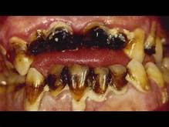
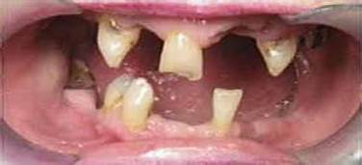
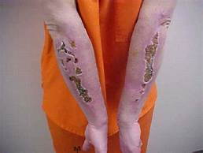
Meth Mouth
Meth Mouth
Meth Arms
Notes:
After months to years of abuse

Slide 31
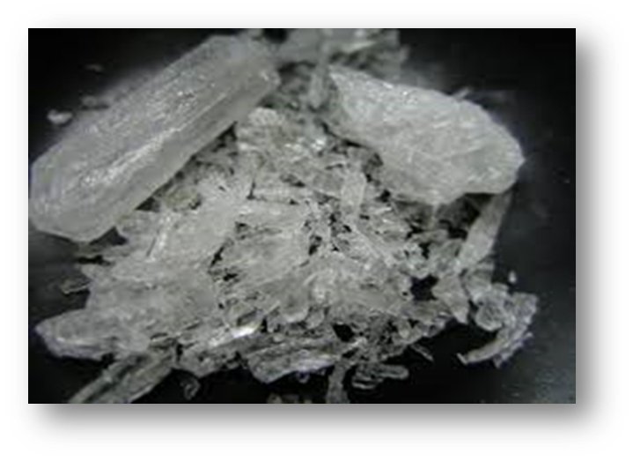
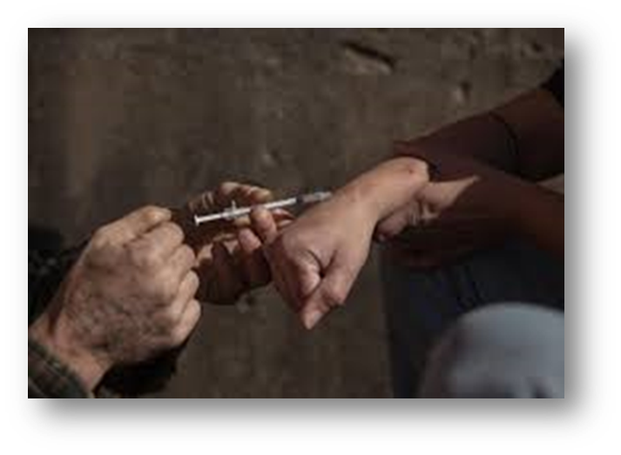
Video
https://v637g.app.goo.gl/pp34kTQbXE7GTbpr7
The Faces of Meth – Before and After

Slide 32
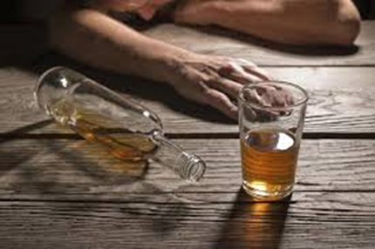
Drugs of Choice
Depressant
Alcohol – legal drug
a. Increases risks of serious health conditions such as heart disease, brain and liver damage, hypertension
b. Rapidly enters the blood stream
c. Is absorbed not digested
d. Contact with Central Nervous System (CNS) causes intoxication
Notes:
CNS – Central Nervous System
Other Depressants – Valium, Tranquilizers, barbiturates, etc

Slide 33
Drugs of Choice
Hallucinogens – distorted perception of reality
  Ecstasy
  PCP aka “wet”, “water”, “woo”
  Mushrooms aka “shrooms”
  Marijuana
  a. Affects memory, learning and perception
  b. Loss of motor coordination
  c. Difficulty with thinking & problem-solving skills

Slide 34
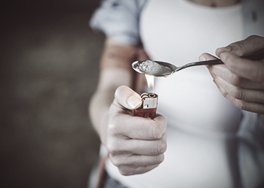
Drugs of Choice
Opioid Types
a. Codeine
b. Morphine
c. Vicodin
d. Fentanyl - powerful
e. Percocet
f. Heroin
Notes:
Fentanyl – Synthetic and short-acting opioid analgesic
100X’s more potent than Morphine
50X’s more potent than Heroin
Primary use is for managing acute or chronic pain associated wit advanced cancer

Slide 35
Opioids
Every 11 minutes someone in the US dies from an opioid overdose
Produces pleasurable effects and relieves pain
Addiction is primary and chronic
Can be obtained via prescriptions for pain
High risk for overdose
Notes:
Major public health problem in the US

Slide 36
Cuyahoga County Stats on Drug Overdoses in 2018
560 drug overdose deaths in 2018; a 23% decrease from 2017 (727 drug overdose deaths in 2017)
440 Opioid-related deaths in 2018 – includes prescription drugs (556 in 2017)
404 Fentanyl-related deaths in 2018 (492 in 2017)
255 Cocaine-related deaths in 2018 (300 in 2017)
153 Heroin-related deaths in 2018 (240 in 2017)
24 Carfentanil-related deaths in 2018 (191 in 2017)
A Decrease in Cuyahoga County for the first time in nearly a decade
Cuyahoga County Medical Examiner’s Office
Notes:
This decrease is due to the hard work so many in the communities have put in to help turn the tide on this terrible crisis

Slide 37
What is Fentanyl?
Named as chief culprit in nation’s opioid crisis
Powerful synthetic narcotic painkiller approved by the FDA; small amounts are extremely dangerous
Rapid and potent effects on the brain and body
Depresses breathing & heart rate leading to death
When used for medical purposes, often given in a shot, a patch on the skin, or in lozenges
When abused, typically swallowed, snorted, or injected
Notes:
Acts faster, even in small doses, than morphine or heroin.
50-100 times more potent than morphine
50 times more potent than many forms of heroin

Slide 38
What is Heroin?
Heroin come from the Asian poppy plant that is sap filled and has high content of morphine which creates heroin
It is highly addictive and the most abused
Pure heroin, a white powder, is rarely sold on the streets
Notes:
Usually seen as a white or brown powder or as a black sticky substance. The differences in color are due to impurities left from the manufacturing process or the presence of additives.
Sometimes cut with other substances such as sugar, powdered milk, cornstarch, or ven poisons like strychnine

Slide 39
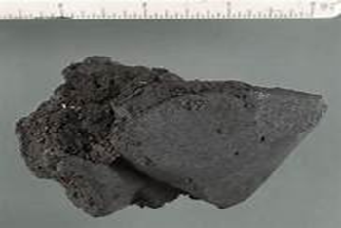
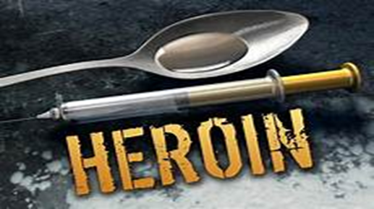
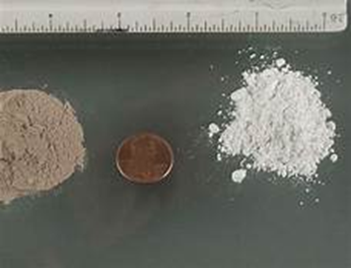
Heroin
It is a white to dark brown powder or tar-like substance
It is smoked, injected, snorted, ingested or sniffed
Black Tar Heroin
Powder Heroin

Slide 40
Heroin
Short Term Effects
Long Term Effects
Euphoria
Dry mouth
Decreased mental ability
Vomiting Lowered Breathing and heart rate
DEATH
Addiction
High degree of tolerance
Brain damage
Liver disease
HIV/AIDS or Hepatitis
Abscesses of the skin
DEATH

Slide 41
Vaping
Inhaling and exhaling an aerosol, aka vapor
Produced by an e-cigarette or similar device
Contains varying amounts of toxic chemicals
Grown in popularity & can be dangerous
Some use to vape Tetrahydrocannabinol (THC)or the synthetic drug Flakka aka the “zombie drug”
New on the block – JUUL – small sleek device looks like a USB flash drive. Popular with teens
Notes:
Flakka is pink or white crystals also know as “gravel” that can be eaten, snorted, injected, or vaporized in an e-cigarette
It produces paranoia, hallucinations and in extreme cases, violent behaviors

Slide 42
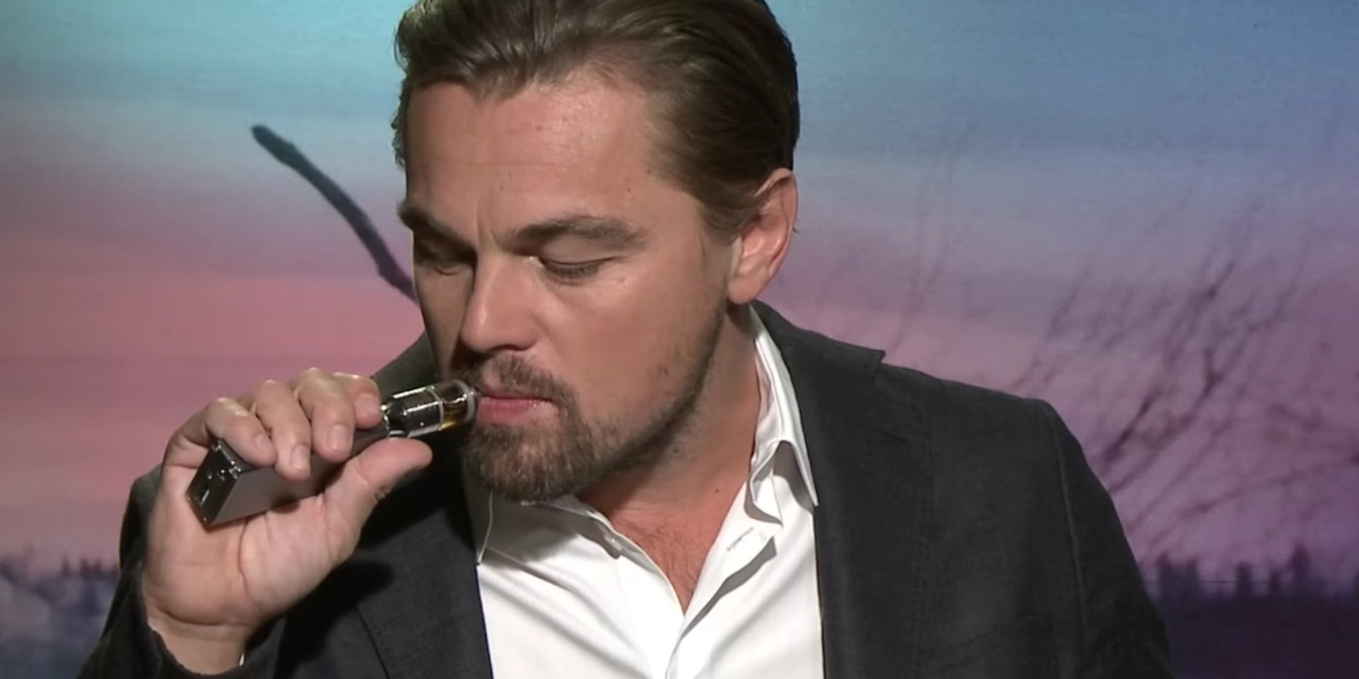
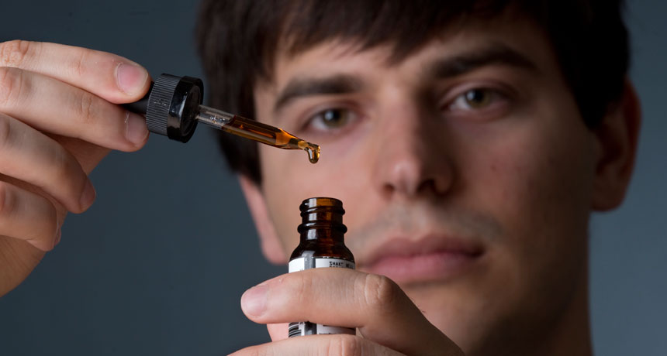
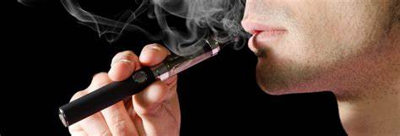
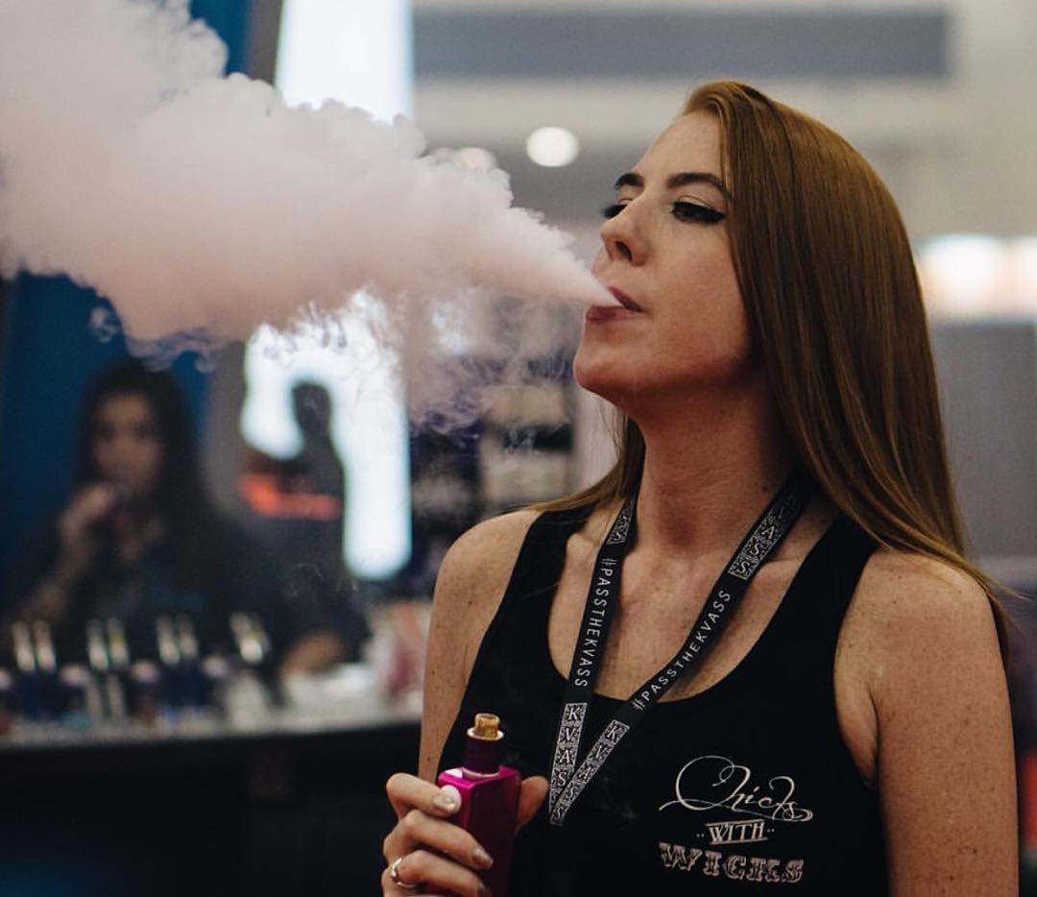
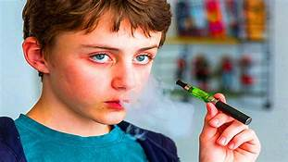
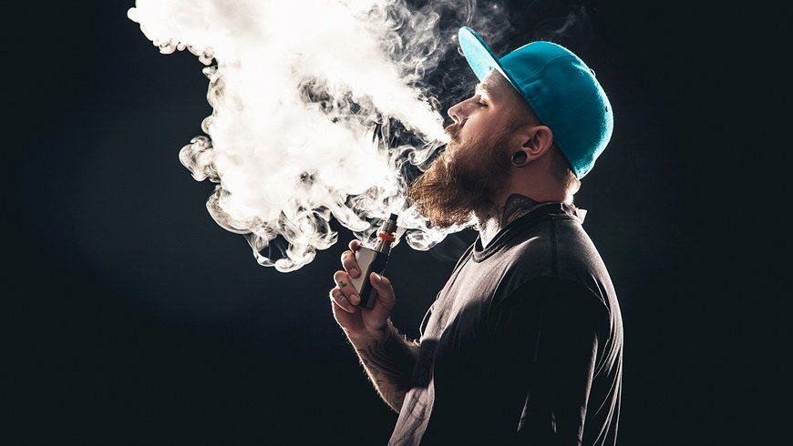
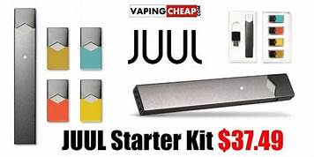
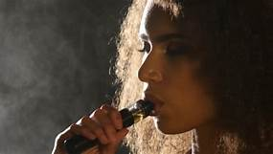

Slide 43
Video
https://www.youtube.com/watch?v=YQ4pEOt0oFY
Video on Vaping

Slide 44
The Road to Recovery
Recognize there is a problem
Know and understand that it is not EASY
Identify triggers for use – people, places, or things
Avoid undue stressors, as much as possible
Reach out to others
Stay Busy
Keep learning about the disease and the benefit of having a healthy lifestyle

Slide 45
Community Resources

Slide 46
Substance Use Disorder Treatment Service Options
Detoxification
a. Salvation Army
b. St. Vincent Charity Medical Center – Rosary Hall
c. Stella Marris
d. Women’s Recovery Center, Ambulatory with MAT
Residential Treatment
a. Community Assessment and Treatment (CATS)
b. Catholic Charities – Matt Talbot for Men and Women

Slide 47
Substance Use Disorder Treatment Service Options
Residential –continued
a. Hispanic UMADAOP
b. Hitchcock Center for Women
c. Signature Health Orca House
d. New Directions – adolescent boys and girls
Outpatient
a. Bellefaire JCB – children and adolescents

Slide 48
Substance Use Disorder Treatment Service Options
Outpatient – continued
a. Catholic Charities
b. Community Assessment Treatment (CATS)
c. Community Action Against Addiction (CAAA)(MAT)
Methadone Treatment to include: Subutex/Suboxone, Vivitrol
d. Signature Health Orca House - MAT
e. Circle of Health (Fentanyl Test Strips)
f. New Directions – adolescent boys and girls

Slide 49
Substance Use Disorder Treatment Service Options
Outpatient – continued
g. Hitchcock Center for Women
h. Women’s Recovery Center
i. Recovery Resources
j. Cleveland Comprehensive Treatment Center - MAT
Sober/Recovery Housing
  a. New Directions – adolescent boys and girls
  b. Briermost Foundation
Notes:
We have not exhausted the list of services. ADAMHS resource guide – give as a handout

Slide 50
Substance Use Disorder Treatment Service Options
Sober/Recovery Housing – continued
c. Cleveland Treatment Center – LOS 90 days
d. Community Action Against Addiction (CAAA)
e. Sober Living Cleveland, Inc. – women; LOS 30-45 days
f. I’m in Transition – serves men and women
g. Jordan Community Residential Center – women; LOS up to 90 days
h. Stella Marris
i. Y-Haven Rising Hope – serves men and women

Slide 51
Additional Services
Prevention – Education to reduce risk-taking behaviors & promote resilience
Peer Recovery Support – social support service designed to fill the need for people in or seeking recovery. Delivered by people who have a lived experience in both substance use and recovery.
Helps people become and stay engaged in the recovery process and reduce the likelihood of relapse.

Slide 52
THANK YOU
QUESTIONS OR COMMENTS

